Slide 1
IBM DATA SCIENCE PROFESSIONAL CERTIFICATE
CAPSTONE PROJECT PRESENTATION
PEEYUSH JAIN

Slide 2
FINAL REPORT | CAPSTONE – THE BATTLE OF NEIGHBOURHOODS - FINDING A BETTER PLACE IN SCARBOROUGH,TORONTO
Introduction: The purpose of this Project is to help people in exploring better facilities around their neighbourhood. It will help people making smart and efficient decision on selecting great neighbourhood out of numbers of other neighbourhoods in Scarborough, Toronto.
Lots of people are migrating to various states of Canada and needed lots of research for good housing prices and reputed schools for their children. This project is for those people who are looking for better neighbourhoods. For ease of accessing to Cafe, School, Super market, medical shops, grocery shops, mall, theatre, hospital, like minded people, etc.
This Project aim to create an analysis of features for a people migrating to Scarborough to search a best neighbourhood as a comparative analysis between neighbourhoods. The features include median housing price and better school according to ratings, crime rates of that particular area, road connectivity, weather conditions, good management for emergency, water resources both fresh and waste water and excrement conveyed in sewers and recreational facilities.
It will help people to get awareness of the area and neighbourhood before moving to a new city, state, country or place for their work or to start a new fresh life.

Slide 3
2. Data Section Data Link: https://en.wikipedia.org/wiki/List_of_postal_codes_of_Canada:_M
Will use Scarborough dataset which we scrapped from Wikipedia on Week 3. Dataset consisting of latitude and longitude, zip codes.
Foursquare API Data: We will need data about different venues in different neighbourhoods of that specific borough. In order to gain that information we will use "Foursquare" locational information. Foursquare is a location data provider with information about all manner of venues and events within an area of interest. Such information includes venue names, locations, menus and even photos. As such, the foursquare location platform will be used as the sole data source since all the stated required information can be obtained through the API.
After finding the list of neighbourhoods, we then connect to the Foursquare API to gather information about venues inside each and every neighbourhood. For each neighbourhood, we have chosen the radius to be 100 meter.
The data retrieved from Foursquare contained information of venues within a specified distance of the longitude and latitude of the postcodes. The information obtained per venue as follows:
Neighbourhood
Neighbourhood Latitude
Neighbourhood Longitude
Venue
Name of the venue e.g. the name of a store or restaurant
Venue Latitude
Venue Longitude
Venue Category

Slide 4

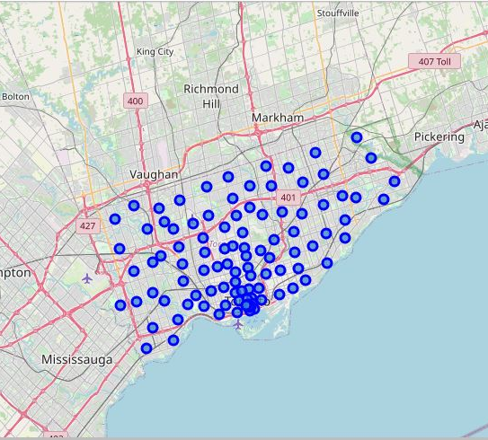
Map of Scarborough

Slide 5
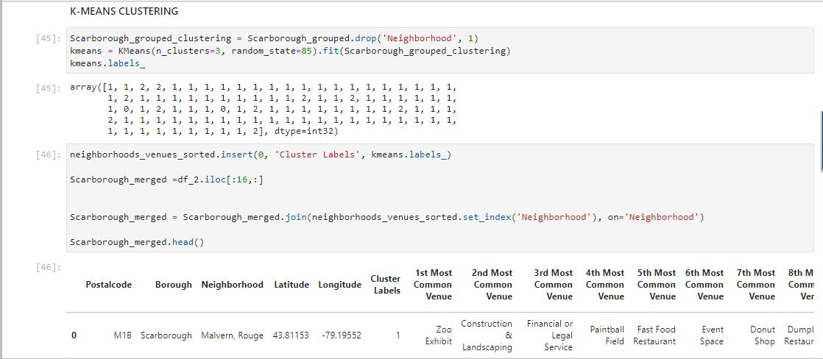
3. Methodology Section Clustering Approach: To compare the similarities of two cities, we decided to explore neighbourhoods, segment them, and group them into clusters to find similar neighbourhoods in a big city like New York and Toronto. To be able to do that, we need to cluster data which is a form of unsupervised machine learning: k-means clustering algorithm.
Using K-Means Clustering Approach

Slide 6
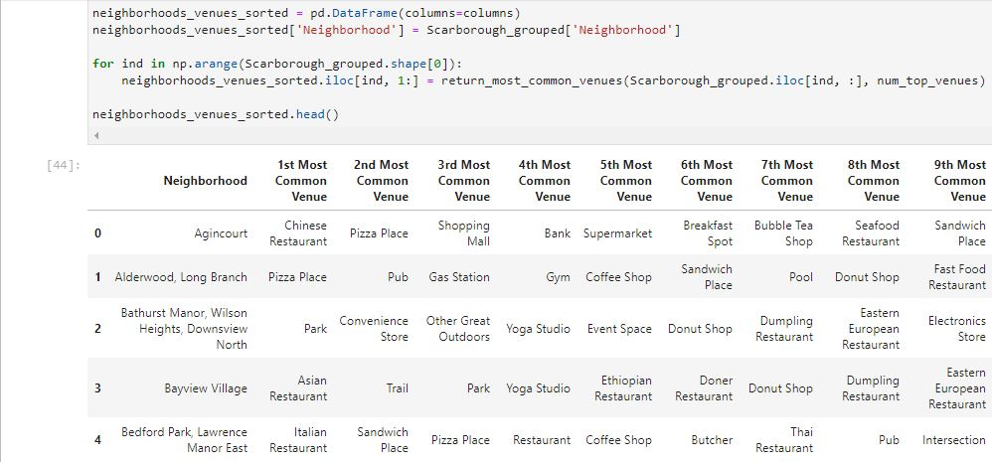
Most Common Venues near Neighbourhood

Slide 7
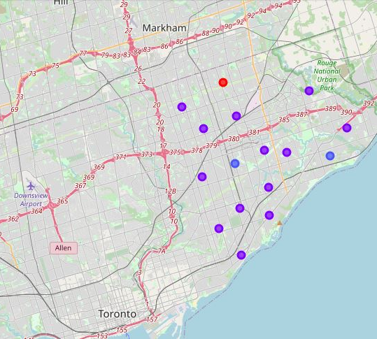
4. Results Section Map of Clusters in Scarborough
Work Flow: Using credentials of Foursquare API features of near-by places of the neighborhoods would be mined. Due to http request limitations the number of places per neighborhood parameter would reasonably be set to 100 and the radius parameter would be set to 500.

Slide 8
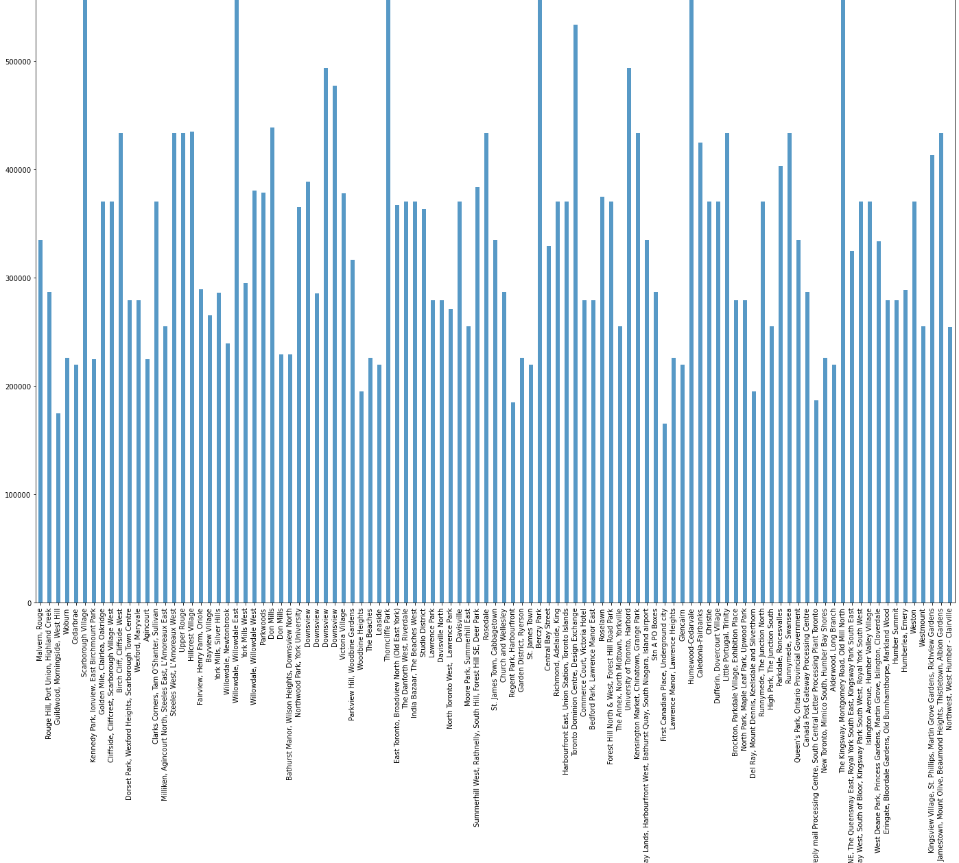
Average Housing Price by Clusters in Scarborough

Slide 9
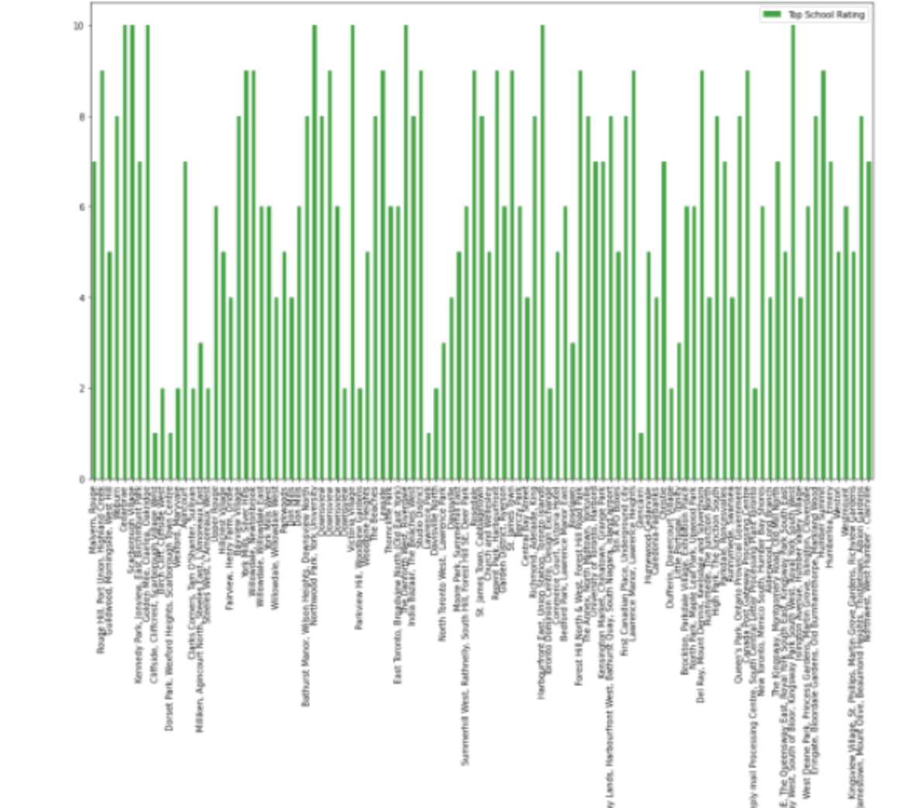
School Ratings by Clusters in Scarborough

Slide 10
The Location: Scarborough is a popular destination for new immigrants in Canada to reside. As a result, it is one of the most diverse and multicultural areas in the Greater Toronto Area, being home to various religious groups and places of worship. Although immigration has become a hot topic over the past few years with more governments seeking more restrictions on immigrants and refugees, the general trend of immigration into Canada has been one of on the rise.
Foursquare API: This project have used Four-square API as its prime data gathering source as it has a database of millions of places, especially their places API which provides the ability to perform location search, location sharing and details about a business.
5. Discussion Section Problem Which Tried to Solve: The major purpose of this project, is to suggest a better neighbourhood in a new city for the person who are shifting there. Social presence in society in terms of like minded people. Connectivity to the airport, bus stand, city centre, markets and other daily needs things nearby.
Sorted list of house in terms of housing prices in a ascending or descending order Sorted list of schools in terms of location, fees, rating and reviews.
6. Conclusion Section In this project, using k-means cluster algorithm I separated the neighbourhood into 10(Ten) different clusters and for 103 different latitude and longitude from dataset, which have very-similar neighbourhoods around them. Using the charts above results presented to a particular neighbourhood based on average house prices and school rating have been made.

Slide 11
I feel rewarded with the efforts and believe this course with all the topics covered is well worthy of appreciation. This project has shown me a practical application to resolve a real situation that has impacting personal and financial impact using Data Science tools. The mapping with Folium is a very powerful technique to consolidate information and make the analysis and decision better with confidence.
Future Works: This project can be continued for making it more precise in terms to find best house in Scarborough. Best means on the basis of all required things(daily needs or things we need to live a better life) around and also in terms of cost effective.
Libraries Which are Used to Develop the Project: Pandas: For creating and manipulating data frames.
Folium: Python visualization library would be used to visualize the neighbourhoods cluster distribution of using interactive leaflet map.
Scikit Learn: For importing k-means clustering.
JSON: Library to handle JSON files.
XML: To separate data from presentation and XML stores data in plain text format.
Geocoder: To retrieve Location Data.
Beautiful Soup and Requests: To scrap and library to handle http requests.
Matplotlib: Python Plotting Module.

